Slide 1

Bucruiser
A hilltop cruiser tracking application

Slide 2
Why this app?
Hilltop Safety Cruiser: a safe and free shuttle service for the students.
In spite of its varied benefits, there are certain practical problems associated with its daily usage.
Can be made more effective by enabling a tracking system for the cruisers.

Slide 3
Features
Requesting or booking a hilltop cruiser
Knowing the booking status
Real-time tracking of vehicle
An option to call hilltop service from the App
To get a notification when cruiser is near the pickup location.
BUPD admins can approve/reject/view requests

Slide 4
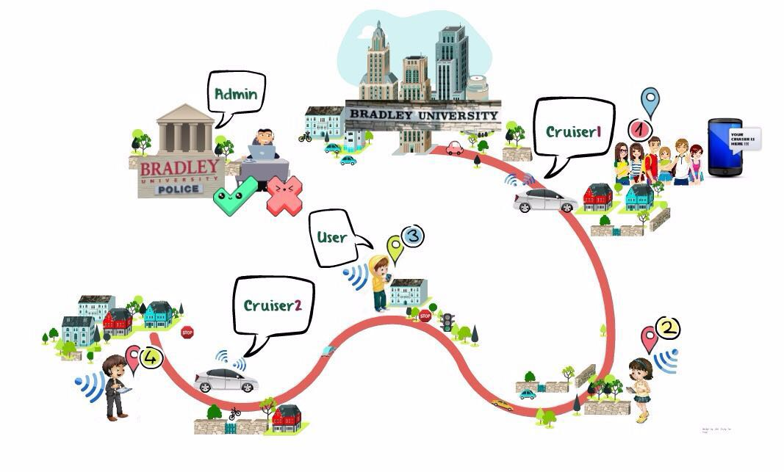
How it works
Notification
Approve/Reject
Track/Status
Booking

Slide 5
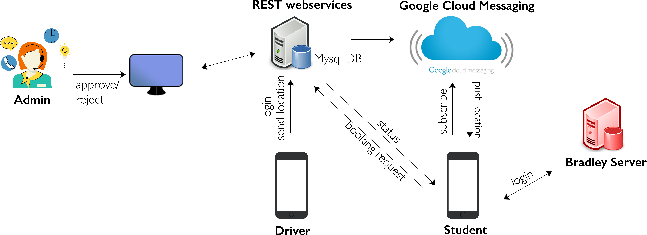
Architecture

Slide 6
Technologies/tools used
Java, HTML, CSS, JavaScript
Rest WEB services, Apache Tomcat, JSON Web Tokens(JWT)
MySQL database
Google Cloud Messaging service(GCM) for pub-sub messages
Android studio, Eclipse

Slide 7
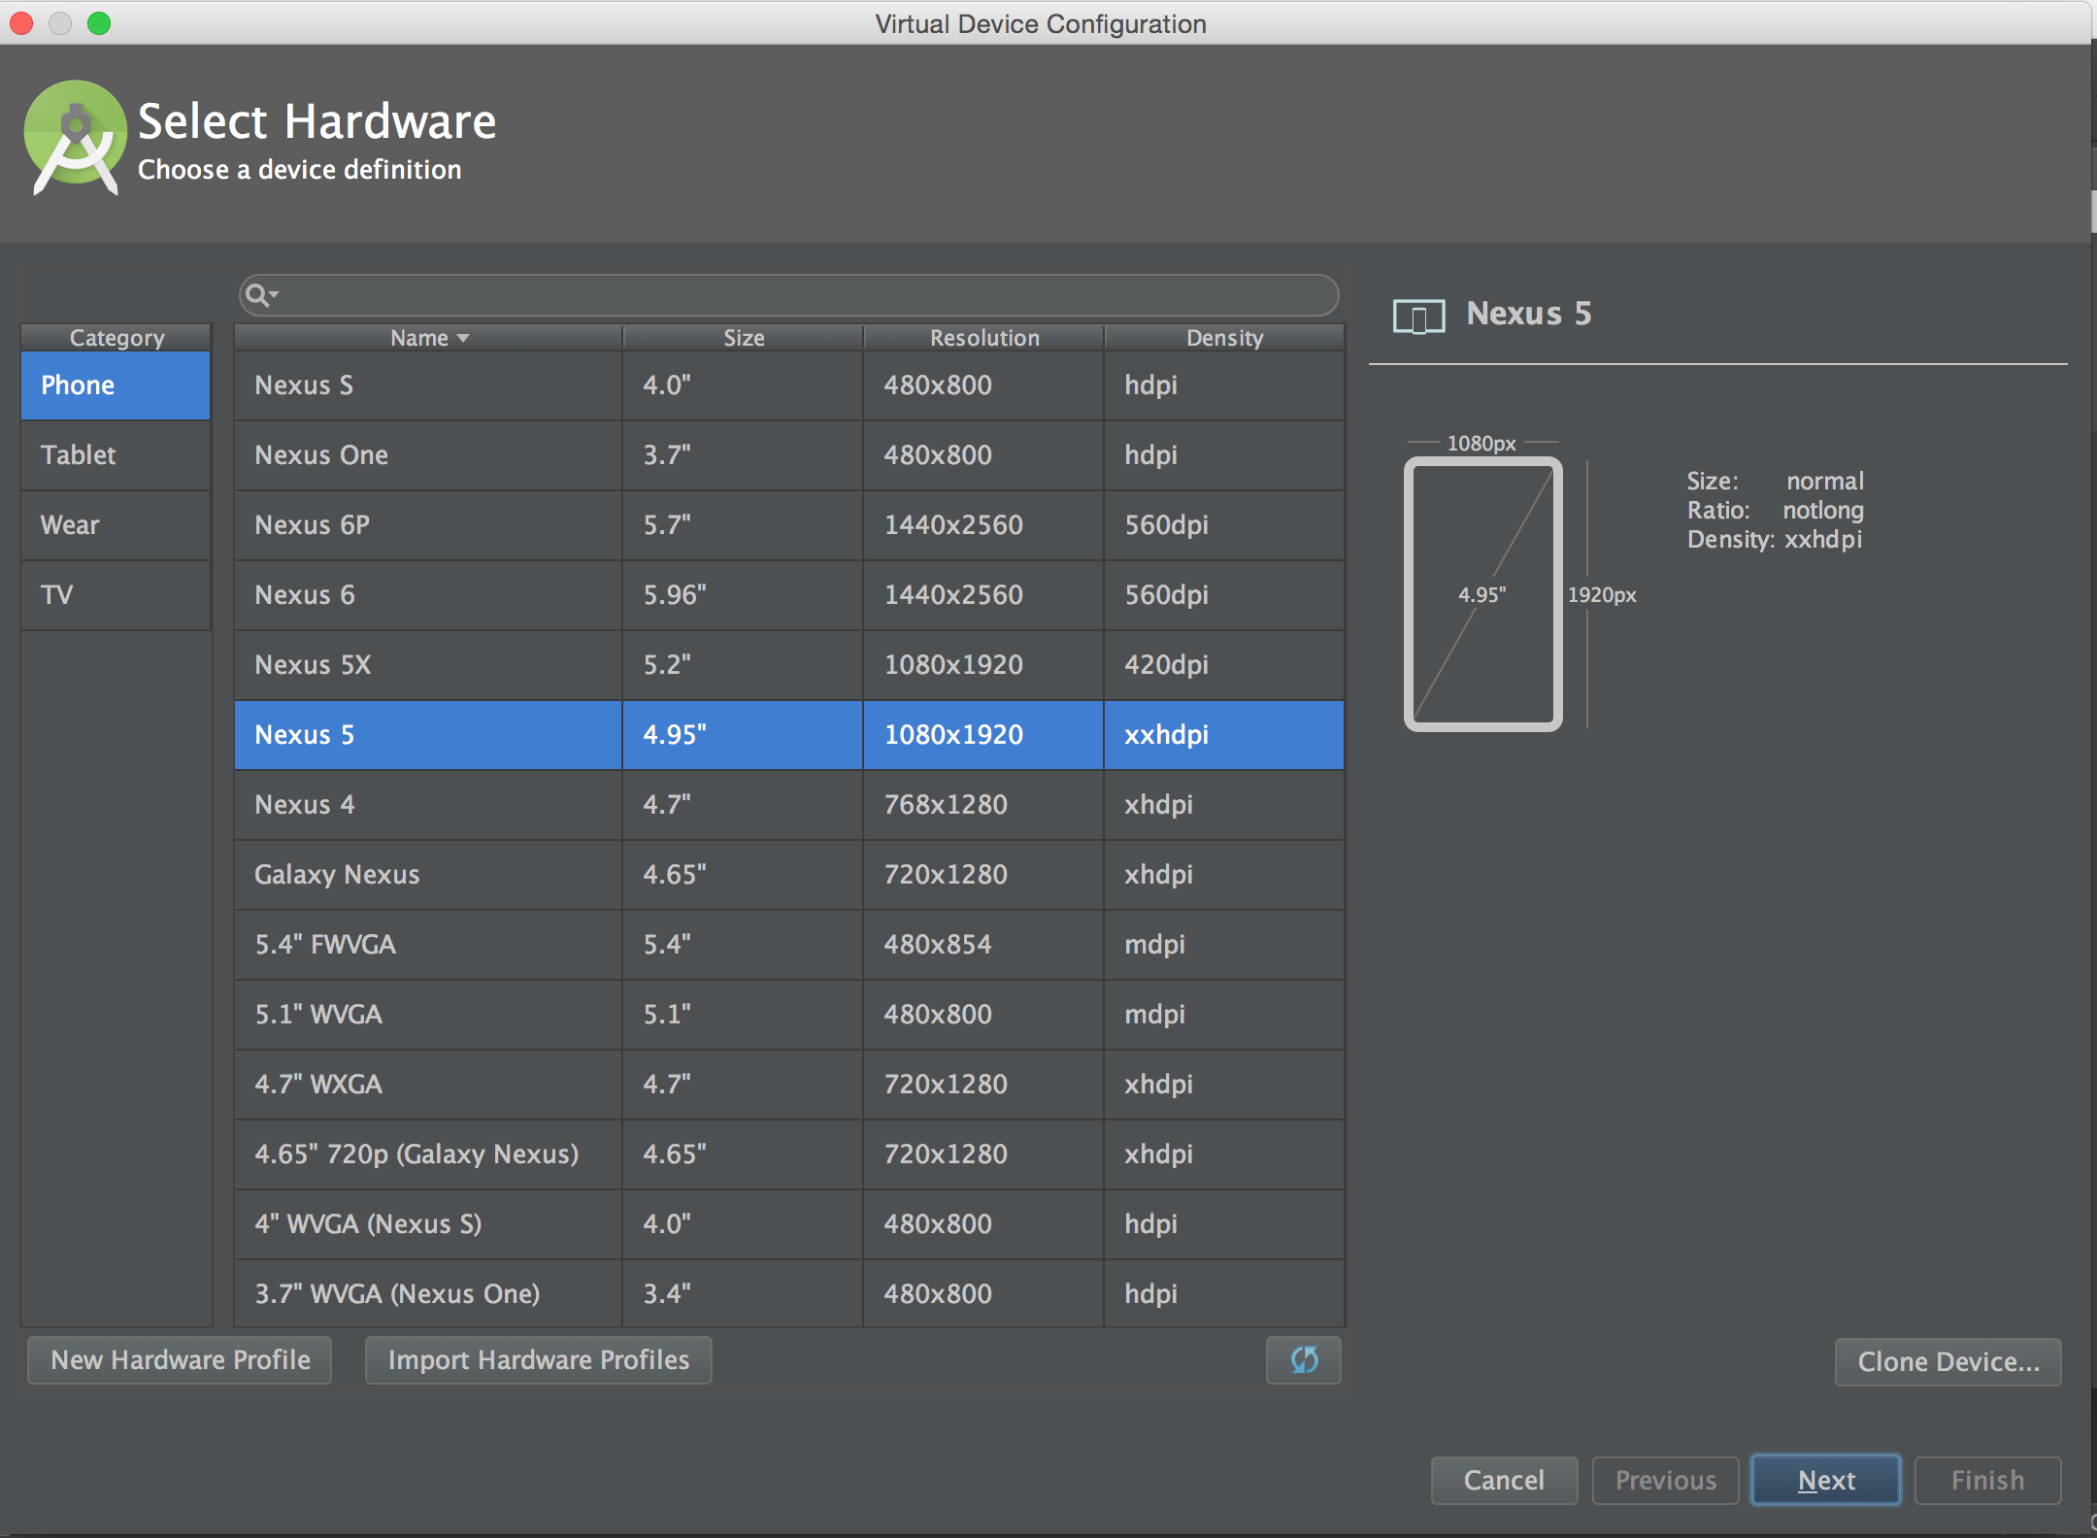
Development process – android studio setup
Download and install Android studio
Created an empty project
Create a virtual device (emulator) from
Tools> Android> AVD Manager > Create Virtual Device

Slide 8
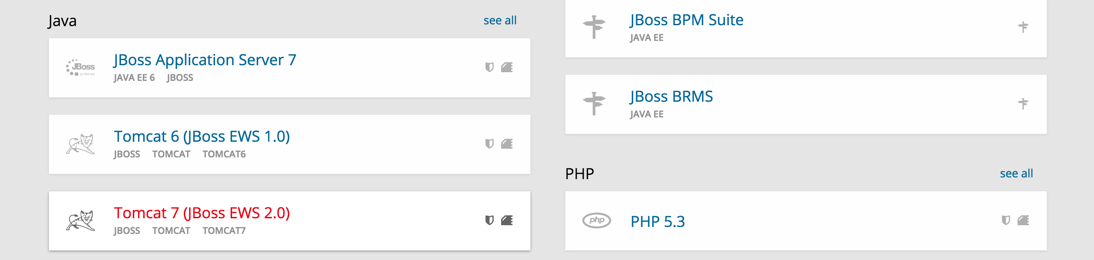
server creation
We needed a Tomact server where we can host our Admin webpage, and Webservices
Signed up for openshift.com (openshift.com allows us to create applications for free with upto maximum 3 cartridges)
Created a new application in openshift and selected the cartridge Tomcat as the server
Also added Mysql cartridge for database, and phpmyadmin cartridge for accessing the mysql server

Slide 9
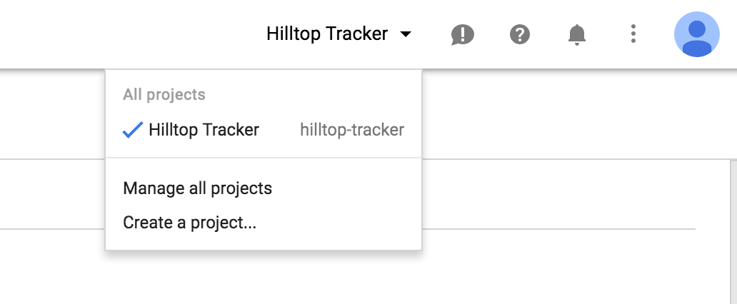
Google MAPS API
Created an application in google developers console
Enabled Google Maps Android API and downloaded the google_maps_api.xml file
Created a new key for the api and replaced it in the above xml file
Copied this xml file on to the values folder under res in the android studio project.

Slide 10
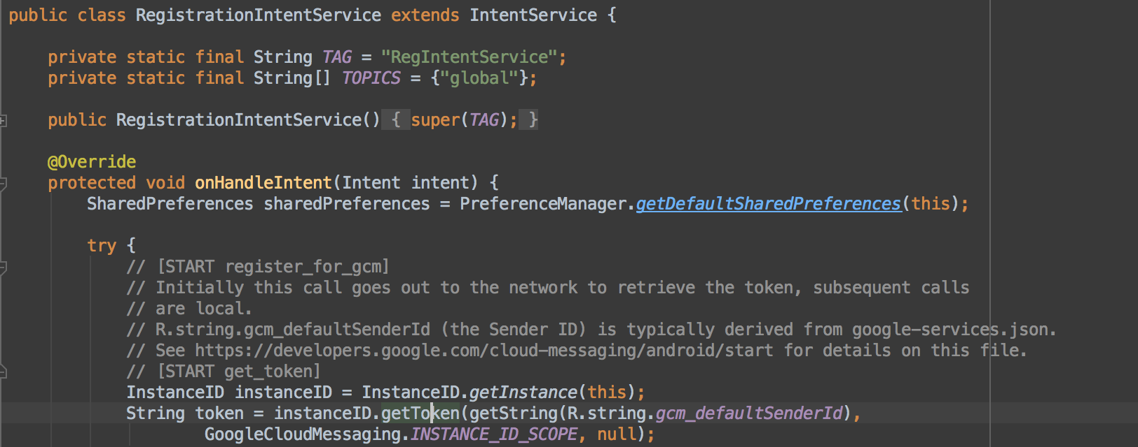
GCM Registration service
Enabled Google Cloud Messaging service from the Google Developer Console
Created a new RegistrationService by extending IntentService that gets the token from the GCM,

Slide 11
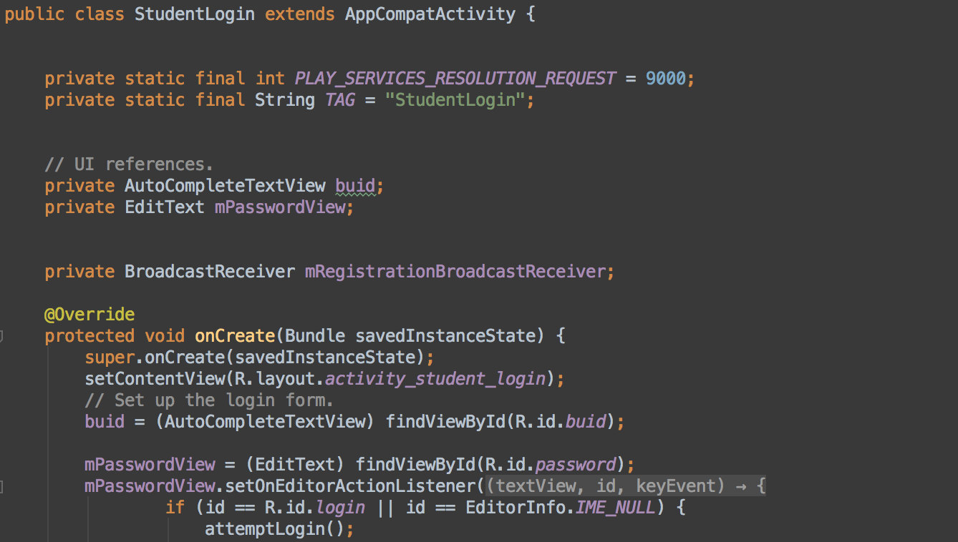
Student side - Login page
Created a Login Activity
Once login is successful, this activity will start the registration service to get new token from server

Slide 12
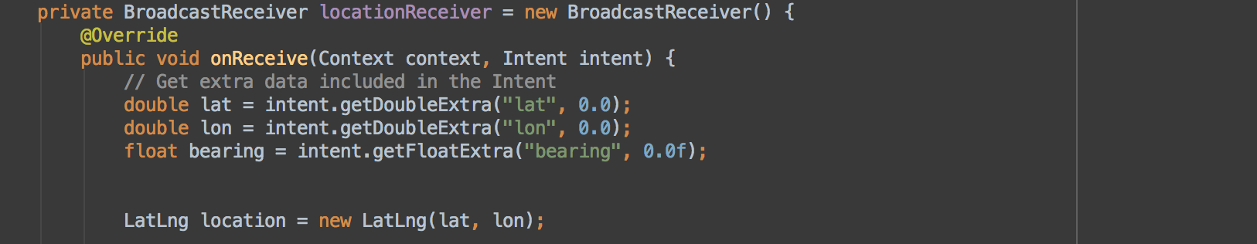
Trackvehicle activity
Login Activity loads TrackVehicle Activity
This is a Google Maps fragment activity which is used for tracking vehicle
Used Broadcast receiver to listen to new messages pushed by GCM

Slide 13
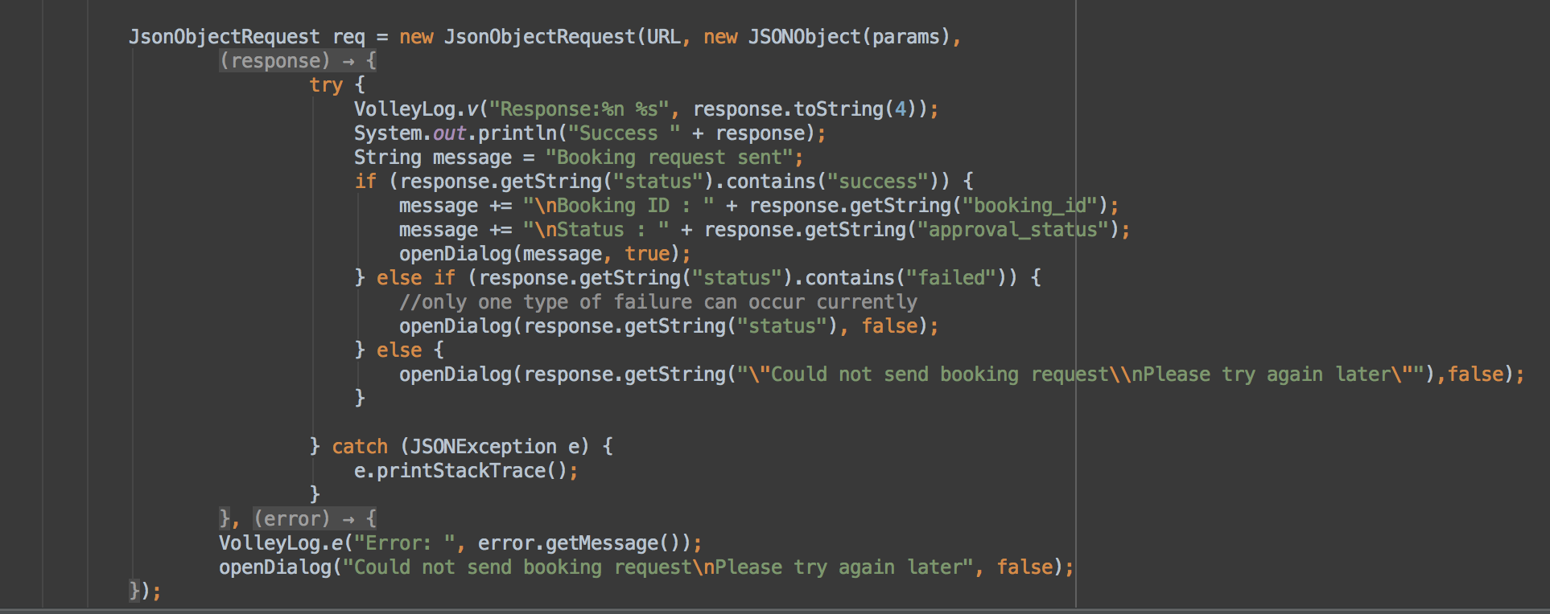
Book Activity
Created a book activity for making new bookings
Used Volley Library for sending JSON Booking request to the Book webservice

Slide 14
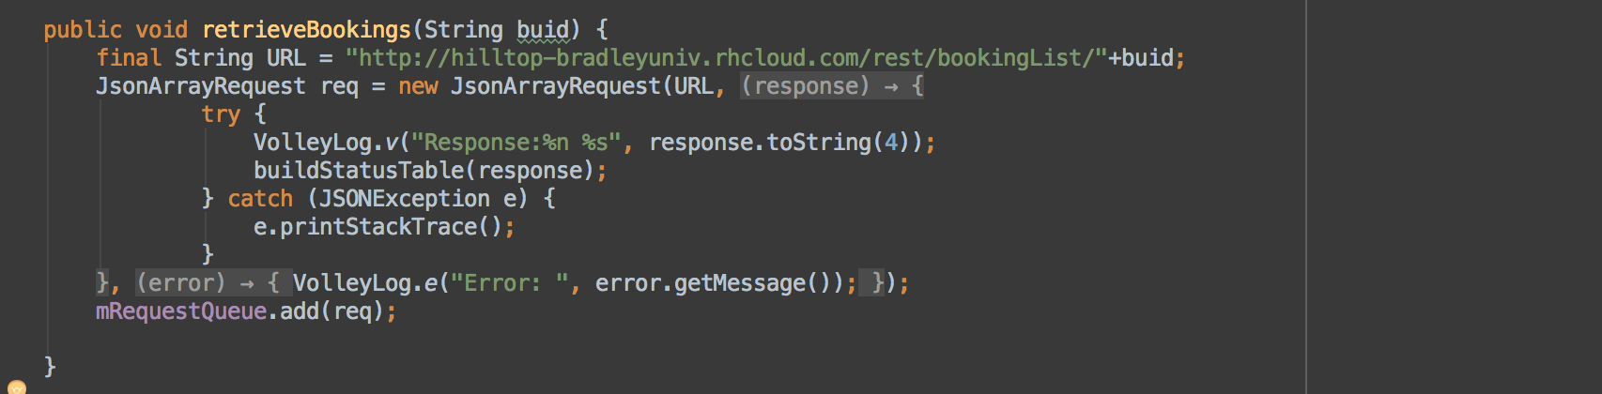
Booking status activity
Created a new activity for retrieving the booking status
Used Volley library,

Slide 15
Driver side
Login Page
Created a Login activity
Used Volley library to send login webservice request to the server
Home Page
Create an activity called Home, which has two options, start/stop sending location
Start button will call a background service called LocationService
Stop button will stop this service

Slide 16
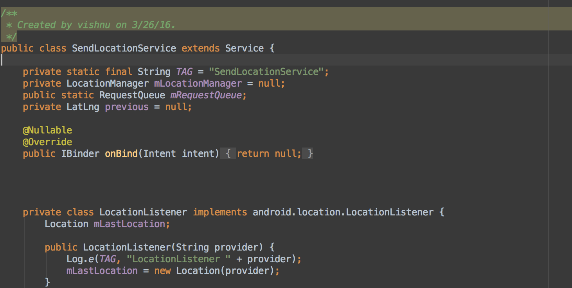
Send location service
Created a class LocationService that extends the class Service
This is used for getting the current location and send it to the server every 5 seconds(configurable)

Slide 17
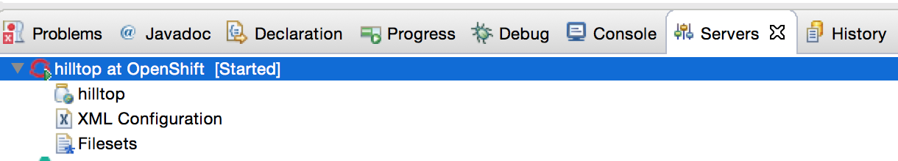
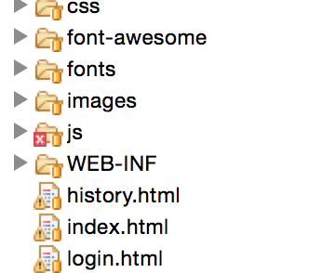
Web page creation – using eclipse
Using eclipse, created a connection to the openshift server
Converted the project to maven and added dependencies for Jersey to create REST webservice
Used SA-Admin bootstrap template to create the layout of pages.
Created 3 pages, index.html, login.html and history.html

Slide 18
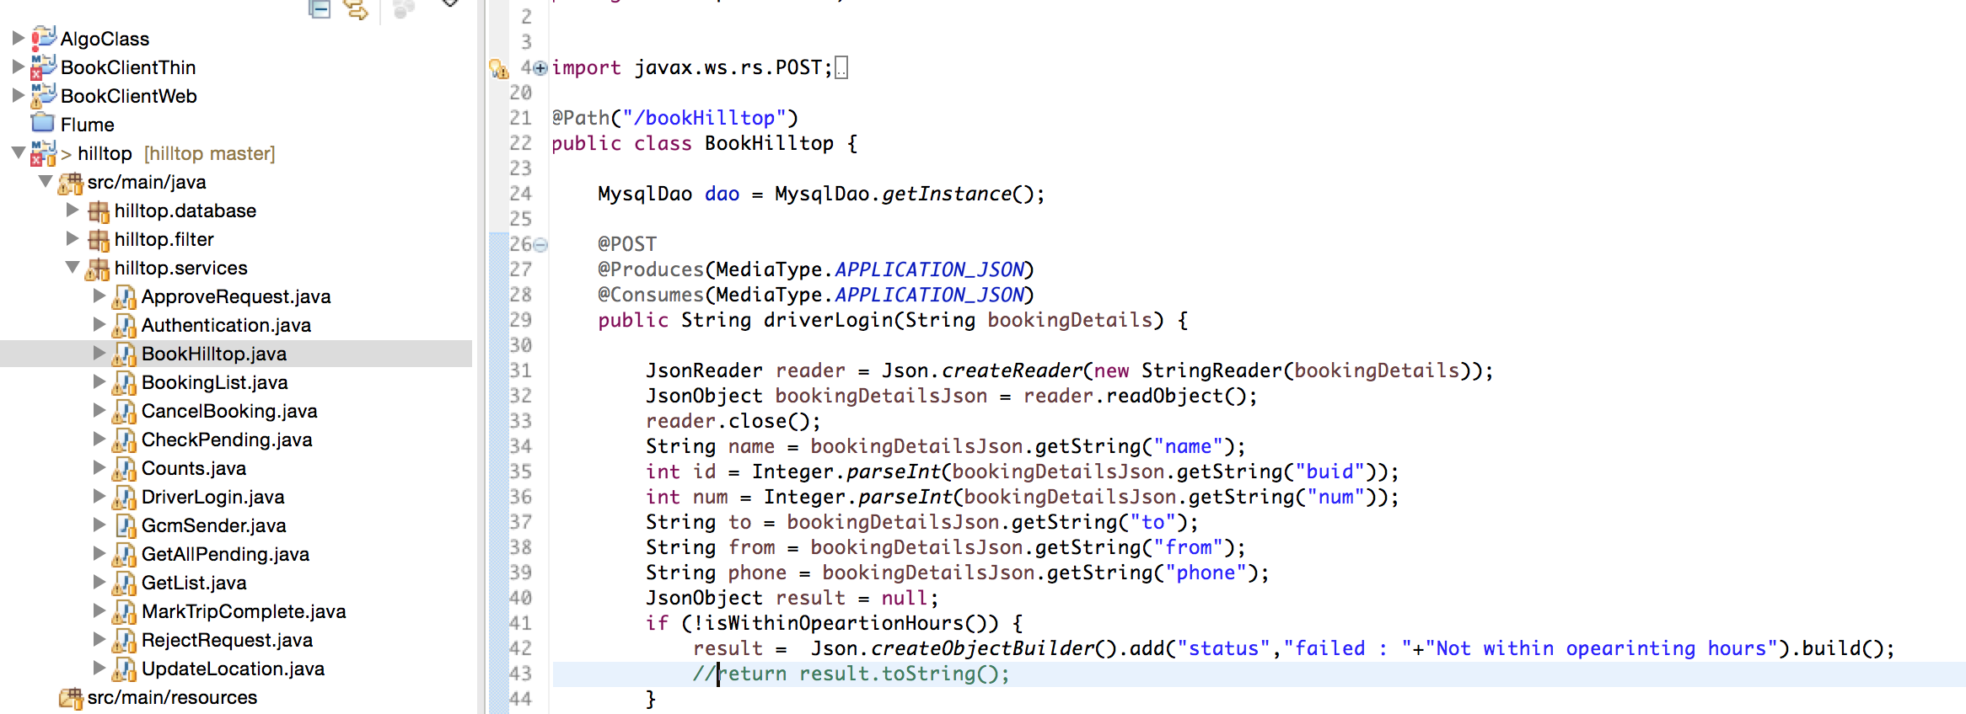
Created the webservices
Created webservice for each functionality such as booking, cancel, track, login, approve, reject etc

Slide 19
Some of the Webservices
ApproveRequest
Authentication
BookHilltop
BookingList
CheckPending
Counts
Login
MarkTripComplete
UpdateLocation

Slide 20
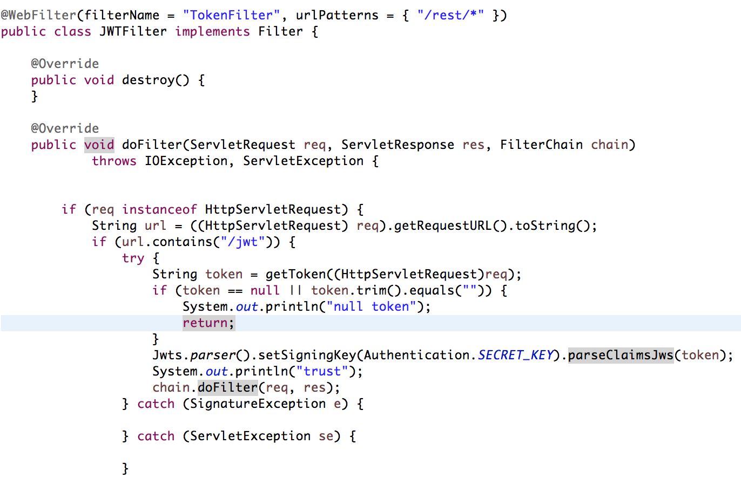
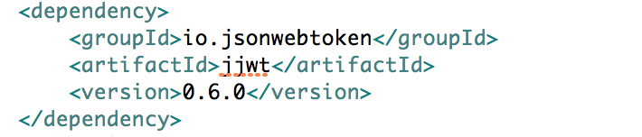
Jwt filter
Created a JWTFilter class that extends Filter to allow only requests that have a valid token attached to it.
This token is created everytime the user logs in.
This is stored in the browser’s local storage/ in the memory of android app to send it along with all the webservice request
Used JWT

Slide 21
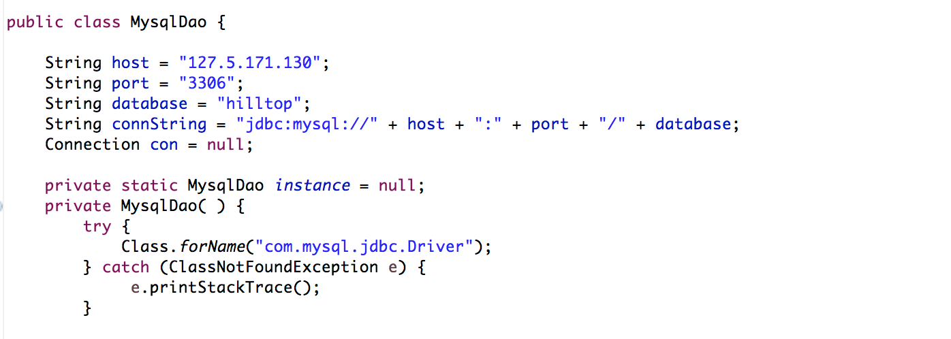
Mysql dao
Created a MysqlDAO class which can connect to the Mysql Cartridge created in the openshift server

Slide 22
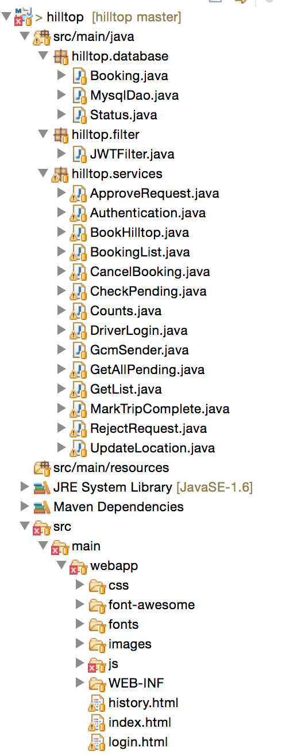
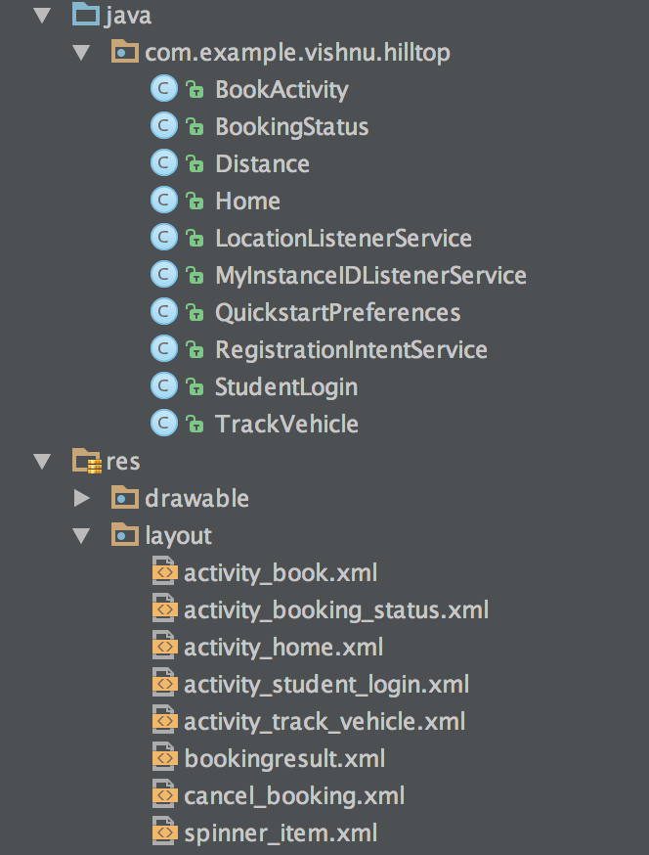
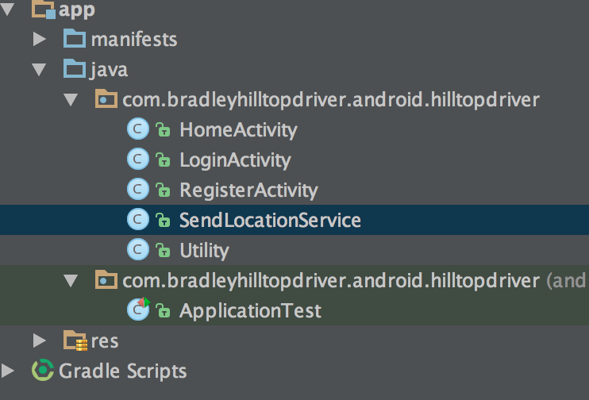
Final package structure
Driver App
Student App
Server side code

Slide 23
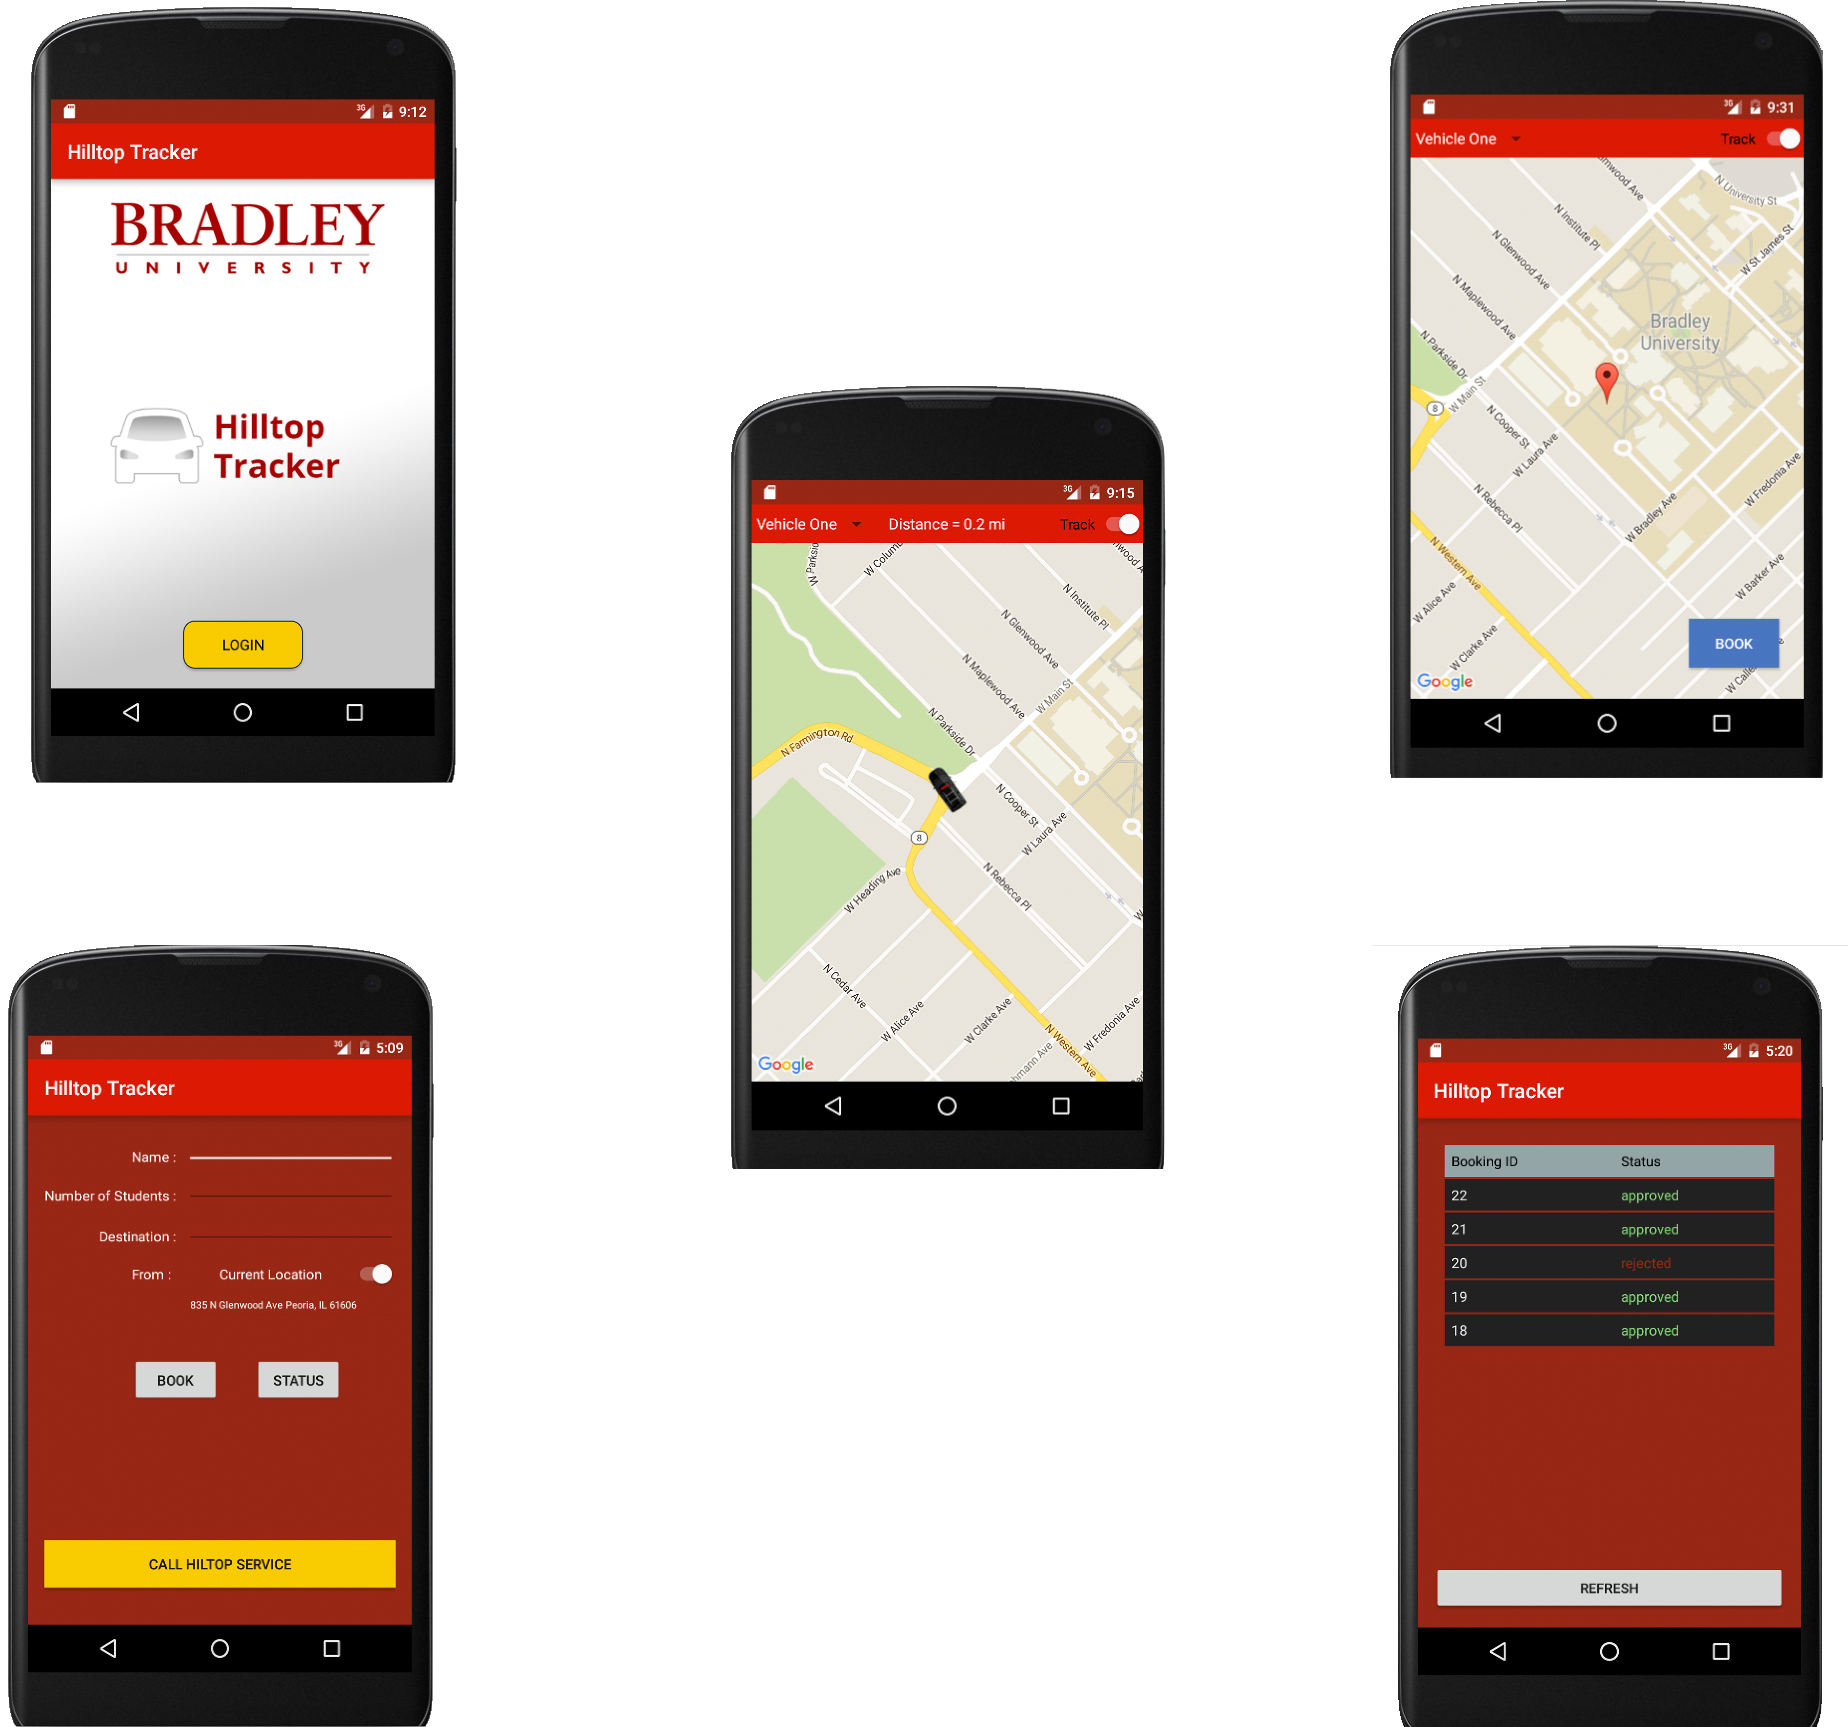
Screenshots – student app

Slide 24
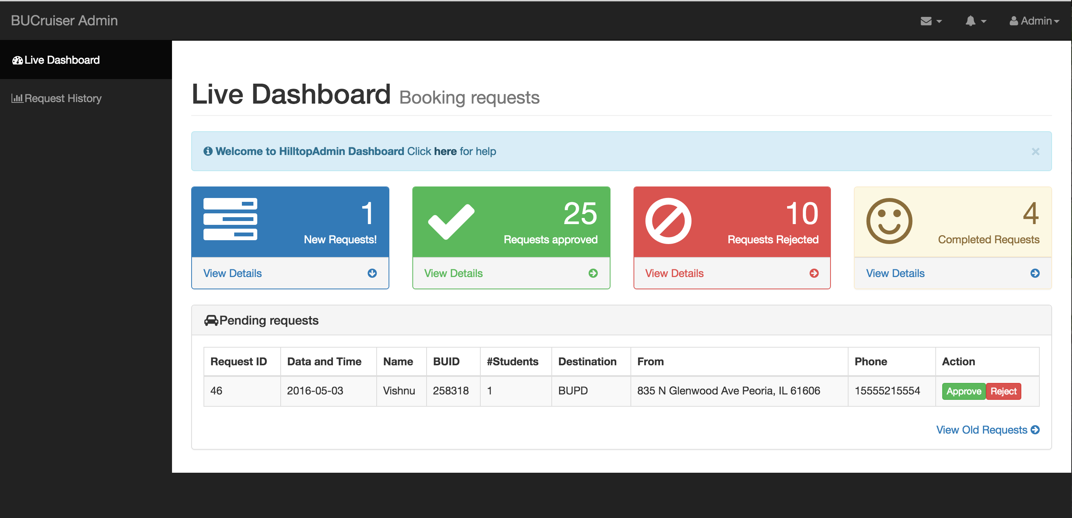
Screenshots - Admin page

Slide 25
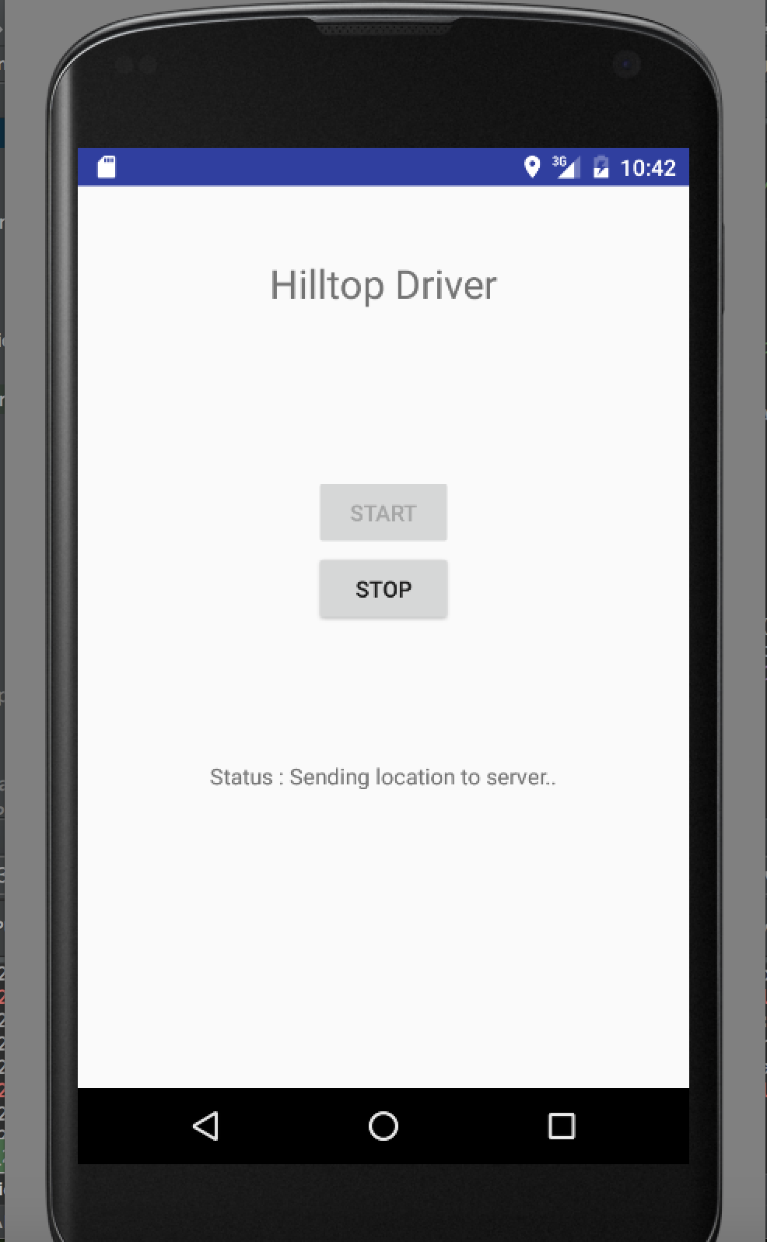
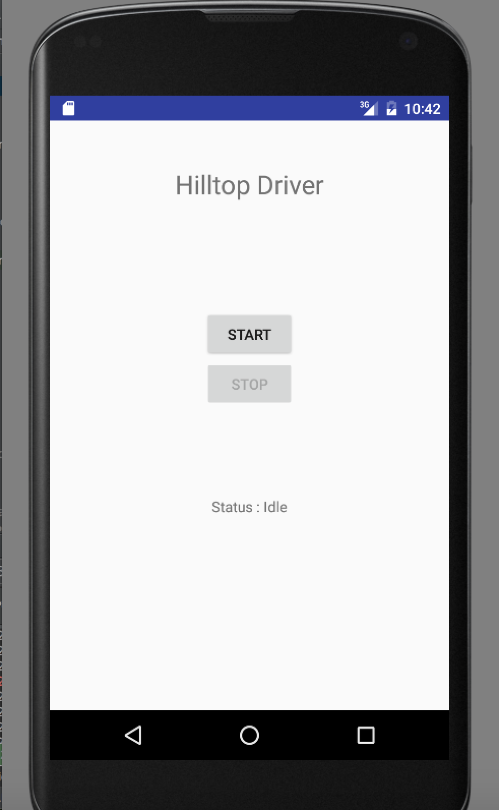
Screenshot - driver

Slide 26
conclusion
The real-time testing results are very promising.
Easy usage and management of Hilltop Safety Cruisers.
No rushing out time and again to check if the cruiser has arrived.
Workload of the admin is reduced by automating the management of the rides.
Statistics and analytics reports are accessible to BUPD facilitating further improvisation.

